Slide 1
Linux Final Project: Creating A Virtual Machine
By: Maricia Epps

Slide 2
Introduction
This project aimed to create a virtual machine by creating and executing a shell script, creating, modifying, and deleting user and group accounts, discovering IP configuration, exploring different networking utility programs, exploring utilities that monitor processes, user activities, and network usage.

Slide 3
Linux File System
The Linux filesystem hierarchy is a tree structure that organizes files into directories or folders.

Slide 4
Navigate the Linux filesystem tree
What is the pwd command an acronym for? What about the cd command?
The pwd command is an acronym for print working directory.
The cd command is an acronym for change directory.
Explain the differences between a relative path and an absolute/full path in Linux.
The difference between relative path and absolute/full path is that relative path is from the current file or directory, and absolute/full path is from the root file or directory.

Slide 5
Create Directories And Files

Slide 6
Copy And Remove Directories And Files

Slide 7
Locate Directories And Files

Slide 8
Linux Shell Scripts
The Linux filesystem hierarchy is a tree structure that organizes files into directories or folders.

Slide 9
Create a shell script
What are the file permissions of the script?
rw-rw-r
What’s the name of the user-defined variable in the script?
text
Which redirection meta-character is used in the script? What does it do?
>> it redirects output and appends it to a file

Slide 10
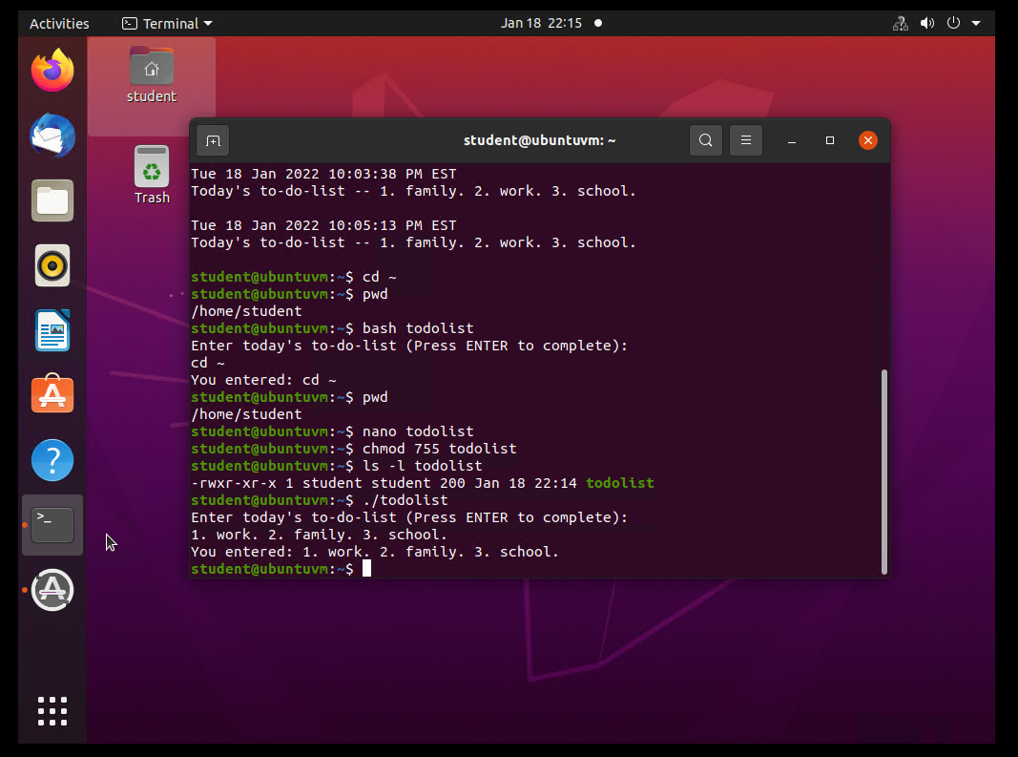
Change Script File Permissions

Slide 11
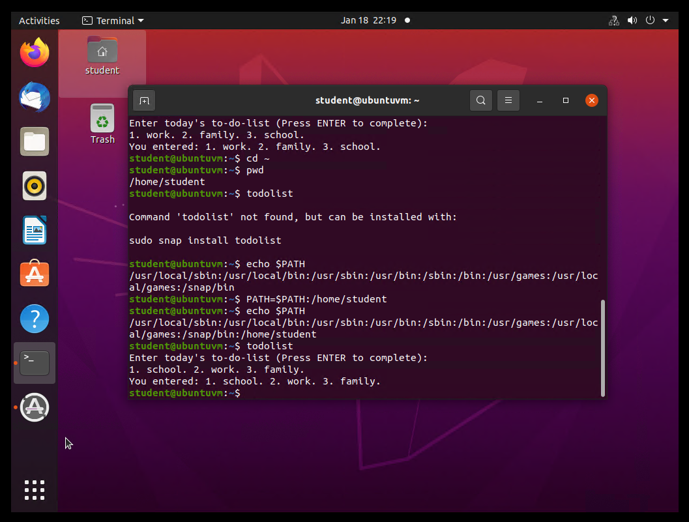
Set The PATH Variable

Slide 12
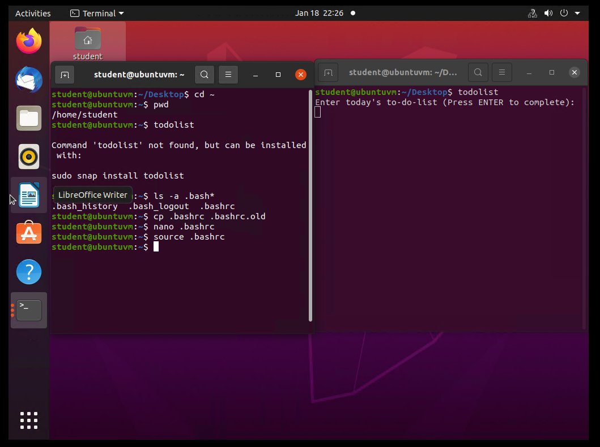
Make The PATH Variable Permanent
Run the todolist script before and after making the PATH variable permanent.

Slide 13
User and Group Management
User and group management is a common administration task.

Slide 14
Add users and groups in CLI
What does the –m option in the useradd command do?
It tells useradd command to add a home directory for the user.
What does the -3 option in the tail command do?
Tail means “end”, and -3 means last three lines.
Which line of the /etc/group file lists members of the “students” group? Copy it here.
.

Slide 15
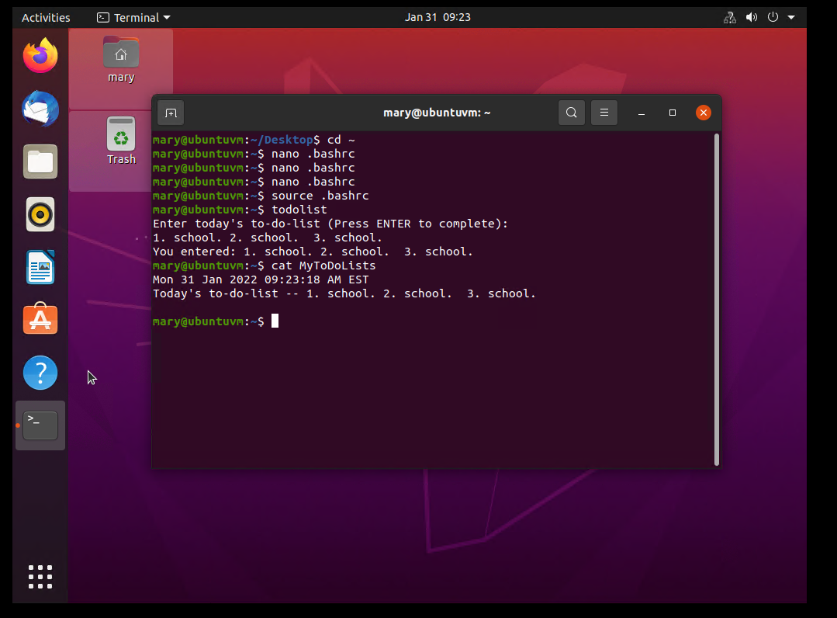
Test User And Group Settings

Slide 16
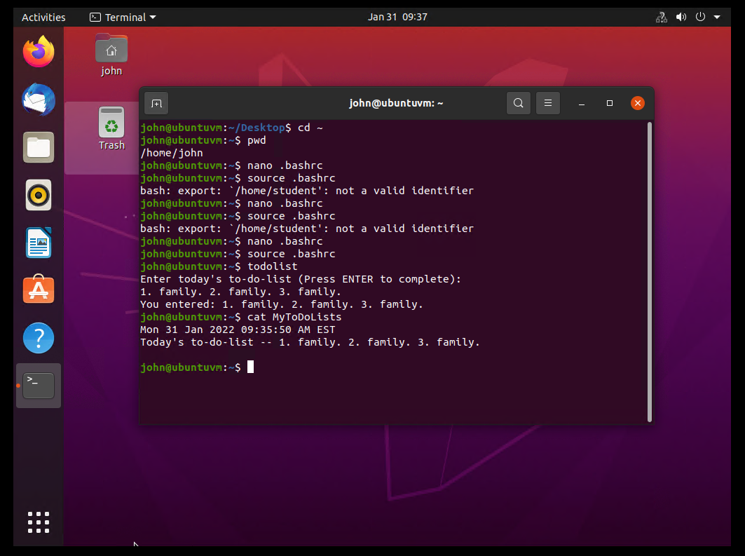
Add Users In GUI

Slide 17
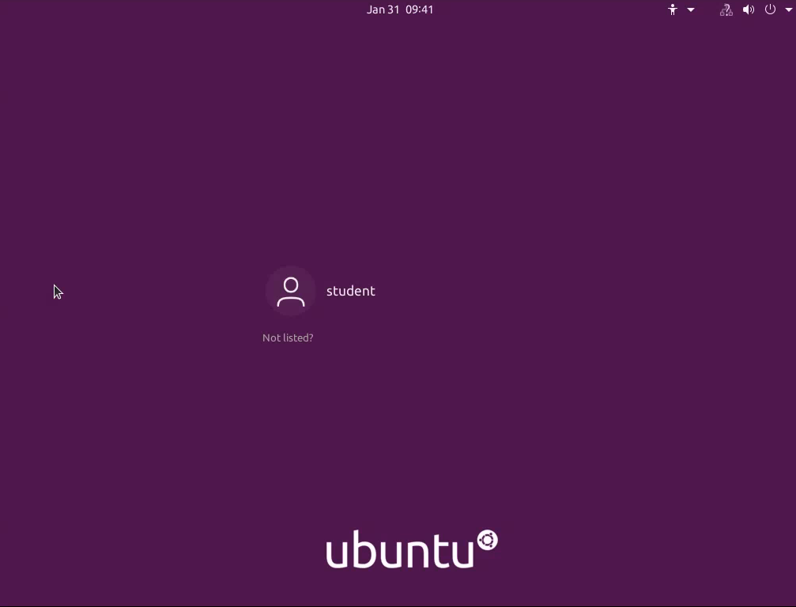
Remove Users And Groups

Slide 18
Network Configuration
To fully participate on a network, a machine requires valid IP configurations including an IPv4/IPv6 address, default gateway, DNS server, etc.

Slide 19
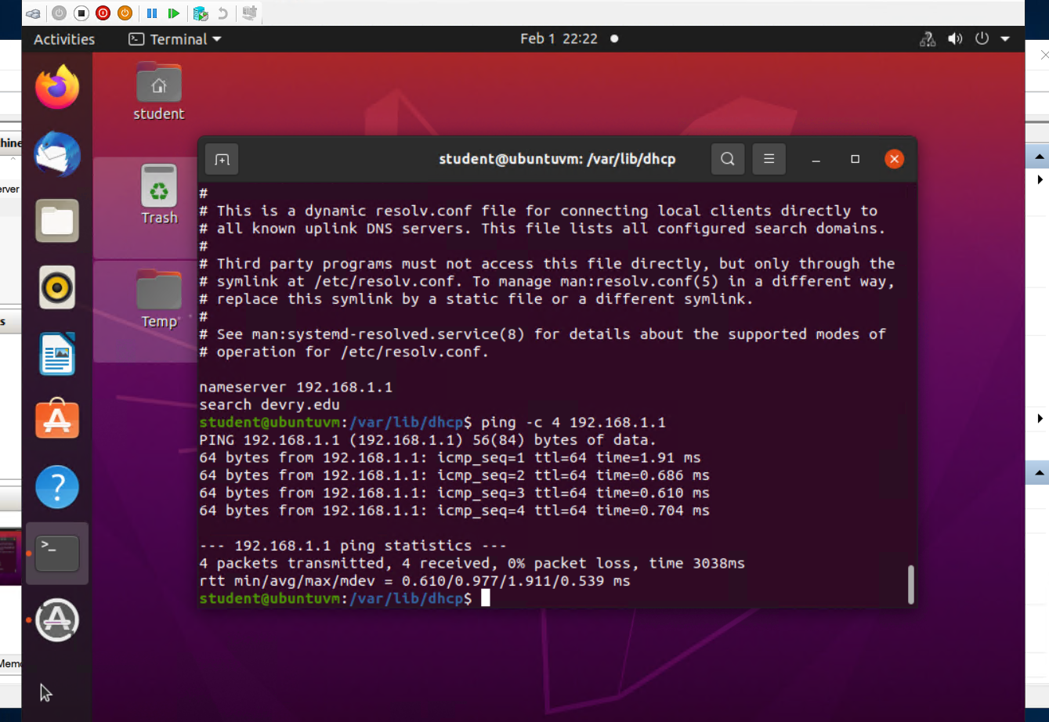
Discover Host IP Configurations
1. What is the IP address of your Ubuntu machine?
192.168.1.104/24
2. What is the IP address of its default gateway?
192.168.1.1
3. What is the IP address of its DHCP server?
192.168.1.1
4. What is the IP address of its DNS server?
192.168.1.1

Slide 20
Manage Network Interfaces
Which DHCP message is shown in the output of the sudo dhclient –v –r eth0 command?
Which four DHCP messages are shown in the output of the sudo dhclient –v eth0 command?

Slide 21
Use Network Utilities

Slide 22
System Performance Monitoring
Monitoring system performance and investigating performance problems are critical to keeping systems up and running. Various CLI and GUI monitoring tools can be used to monitor system performance and help identify the root causes of problems.

Slide 23
Monitor Linux processes
What is the default action of the 15 SIGTERM kill signal?
It will kill the selected process.
In the System Monitor window, click on % CPU to sort the processes by CPU load. Which process shows the highest percentage of CPU usage?
The gnome-shell has the highest CPU usage.

Slide 24
Monitor user activities
Issue the sudo accton on command to turn on GNC accounting. Run the sudo updatedb command. Enter lastcomm updatedb to check if the updatedb command was executed before.
What flag value is displayed in the output?
S
Why is the name of the user who ran the processes shown as root, not student?
Because sudo was used to run the command which stands for “super user do”, that is why it is under root and not student.

Slide 25
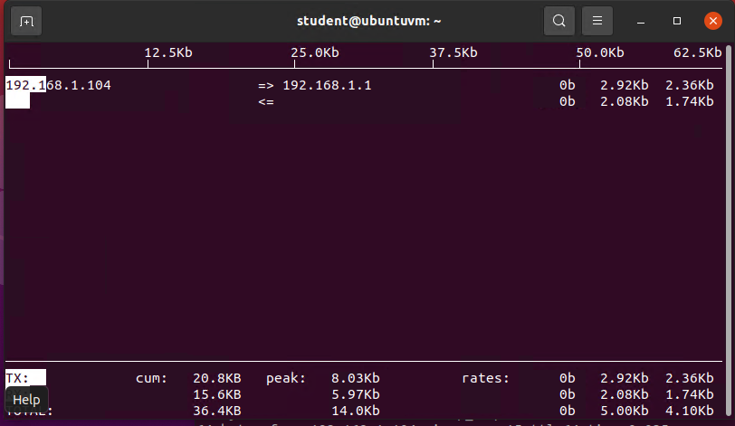
Monitor Network Bandwidth Usage

Slide 26
Challenges
A challenge I faced when completing this project was not getting the correct output due to my input being incorrect mostly due to grammatical errors.

Slide 27
Career Skills
Problem-Solving
Networking
Security
Scripting Language
Active Directory
Backup

Slide 28
Conclusion
This project aimed to create a virtual machine by creating and executing a shell script, creating, modifying, and deleting user and group accounts, discovering IP configuration, exploring utilities that monitor processes, user activities, and network usage. Files in a directory are physically stored in the filesystem of a disk partition. A solid understanding of the filesystem hierarchy is the foundation of storing and retrieving data in Linux. A script is interpreted and executed by the Linux shell. Therefore, any command that can be entered on the Linux command line can be part of a shell script.

Slide 29
References
MindTap - Cengage Learning
Instructor based learning

