Slide 1
Smart Home Security System
By: Maricia Epps

Slide 2
CEIS 101 Course Project
This project aimed to develop a smart home security system by designing the prototype using Tinkercad. It uses the hardware included in my IoT Tech Core Kit to build the system while using Arduino IDE for programming. Various devices are being used to monitor this smart home system. These include a door sensor to detect when the door is open and closed—a distance sensor to monitor a possible home intruder. Also, automated lights to turn on when it is dark.

Slide 3
Step 1: Develop Prototype in Tinkercad

Slide 4
Circuit

Slide 5
Code

Slide 6
Step 2: Inventory hardware and build circuit

Slide 7
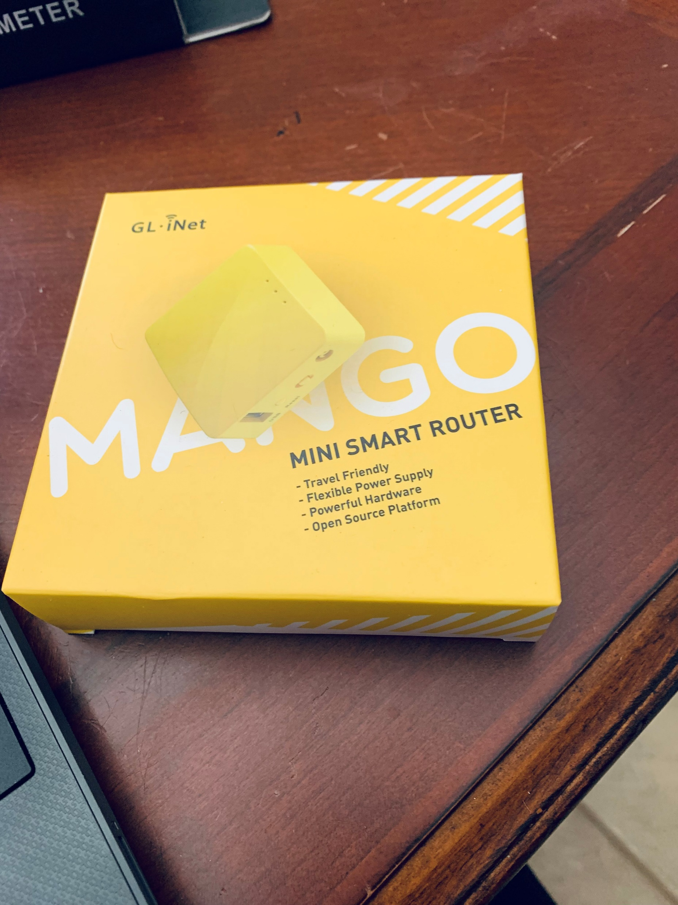
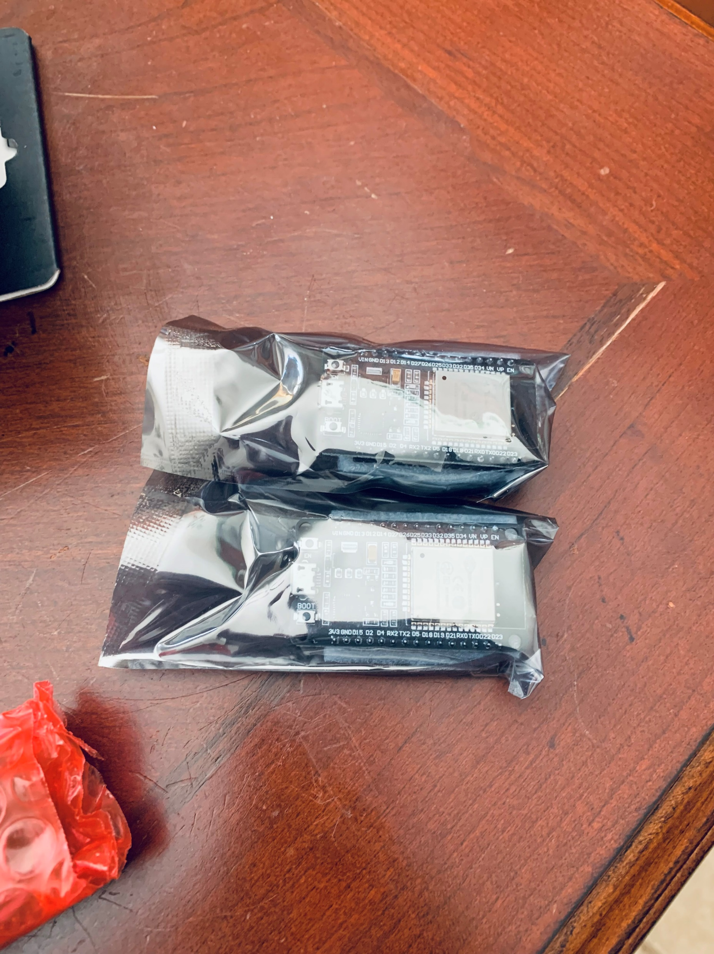
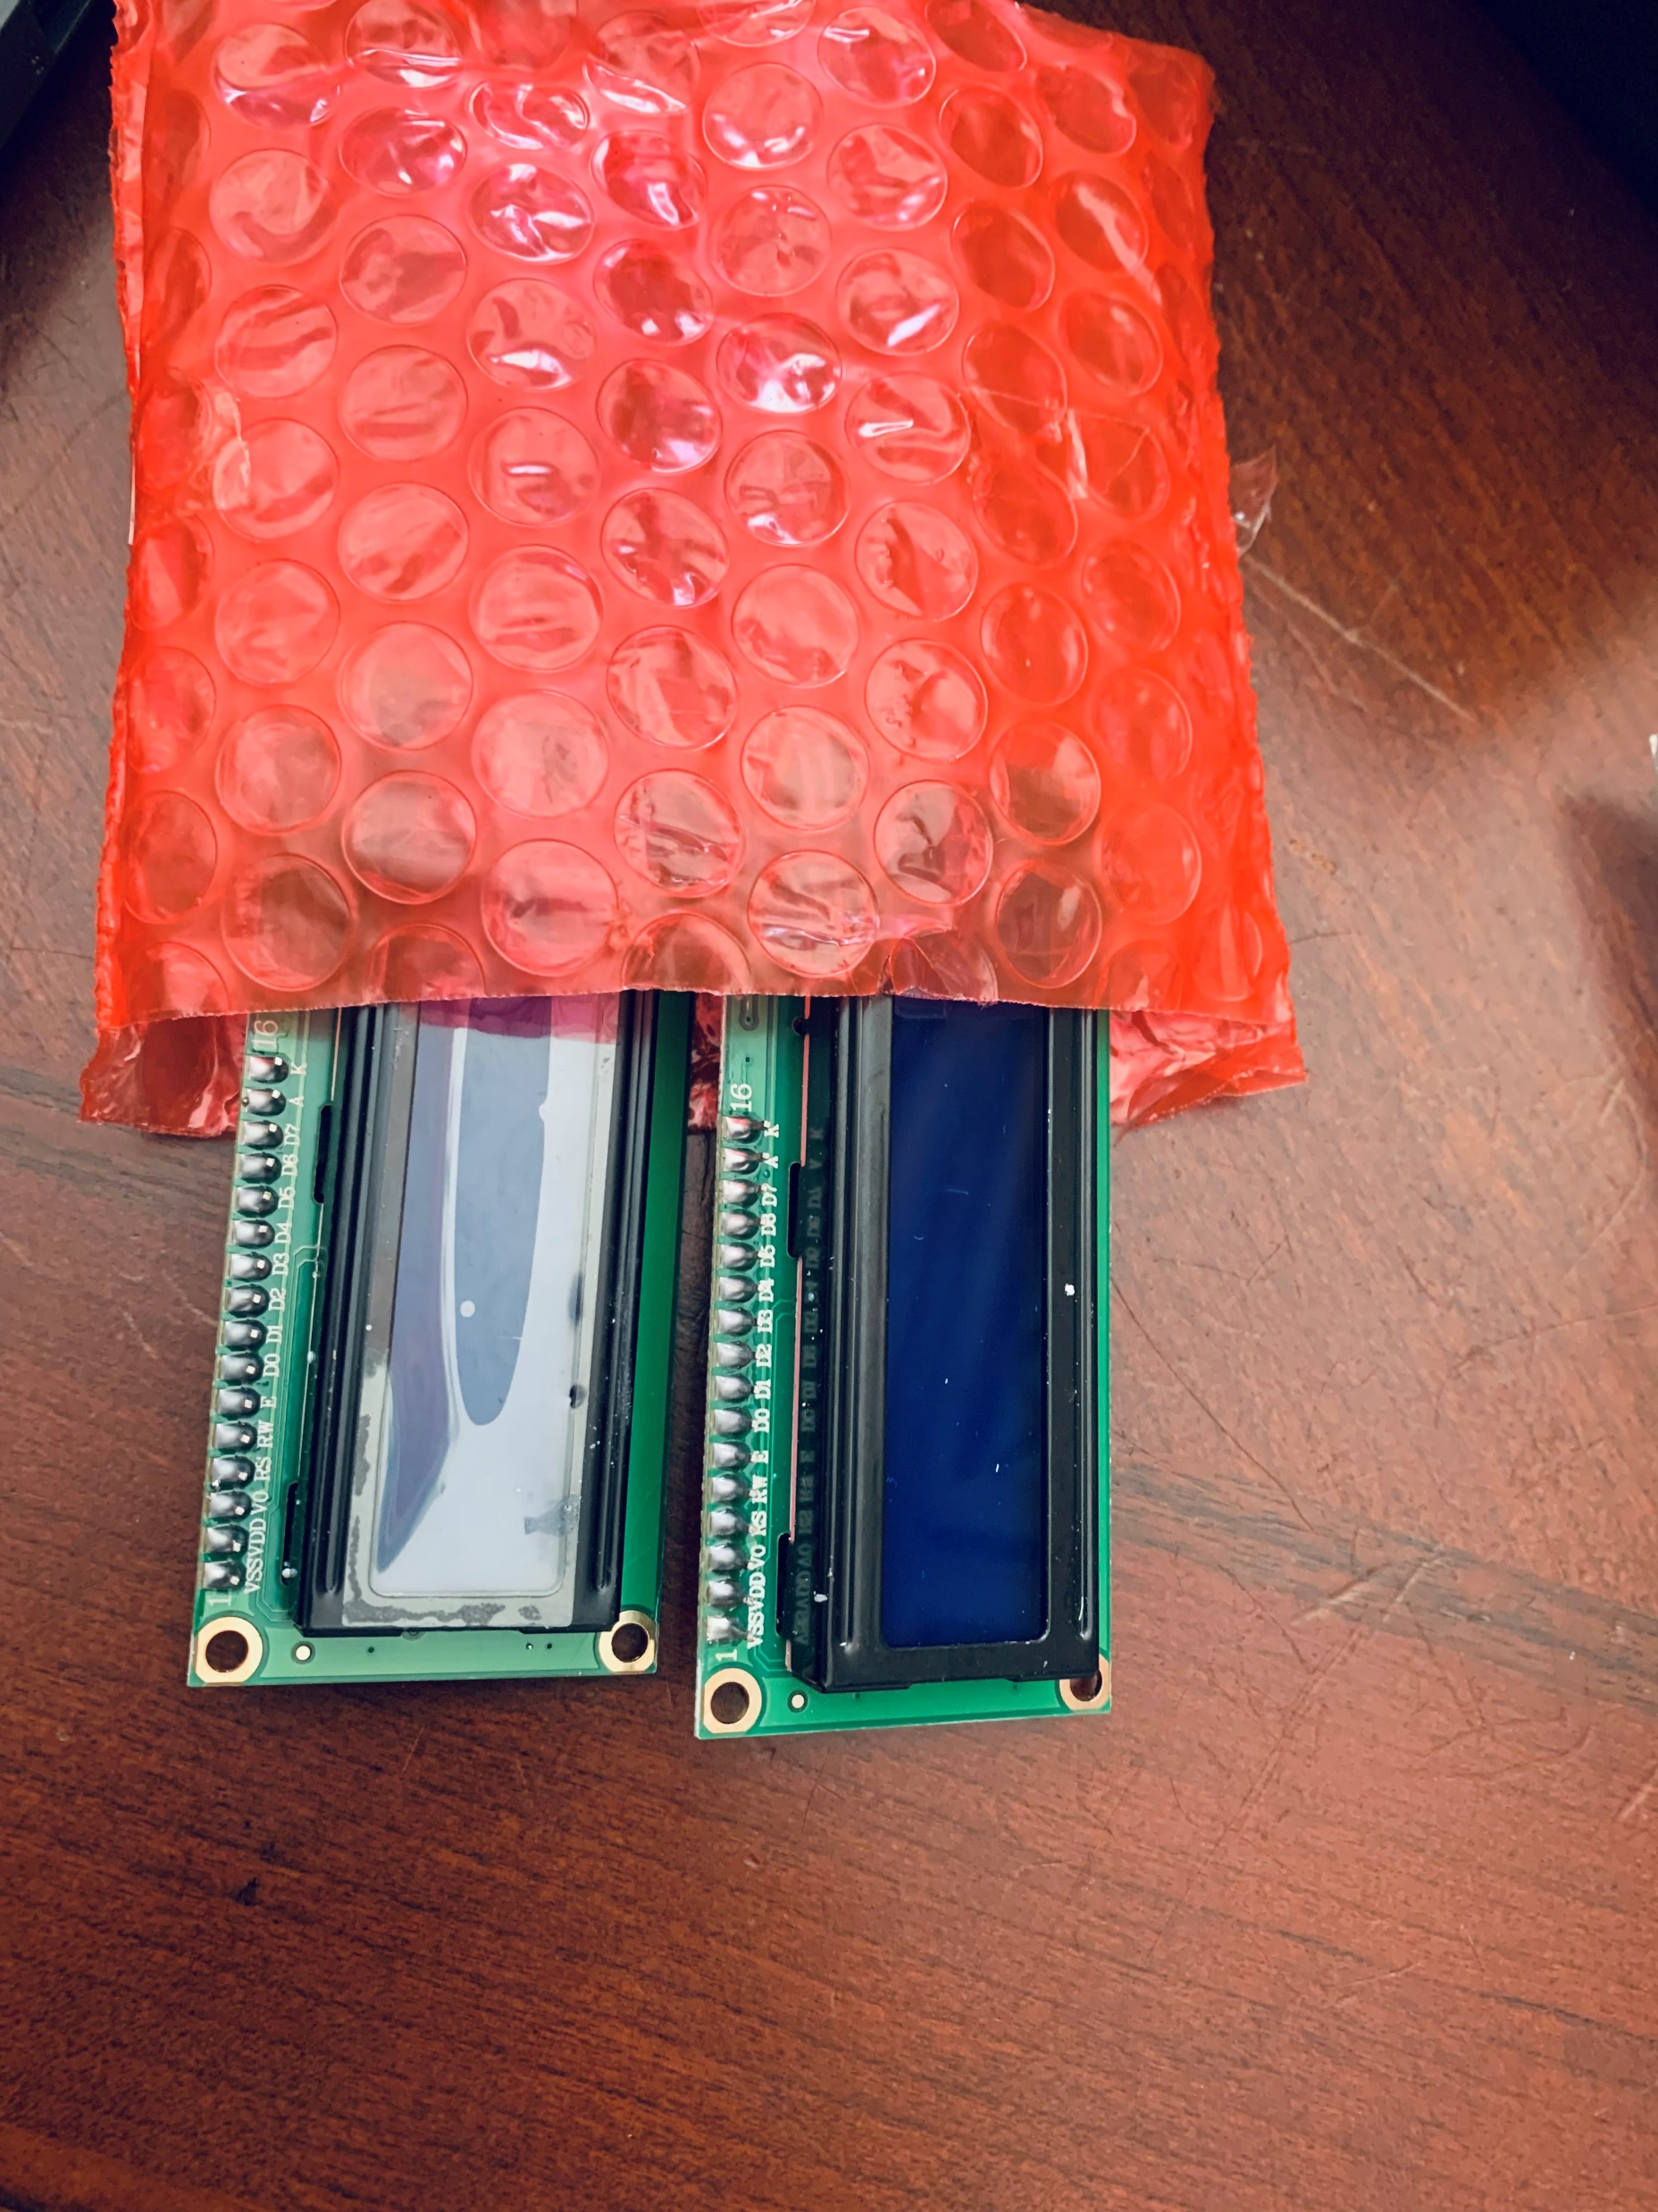
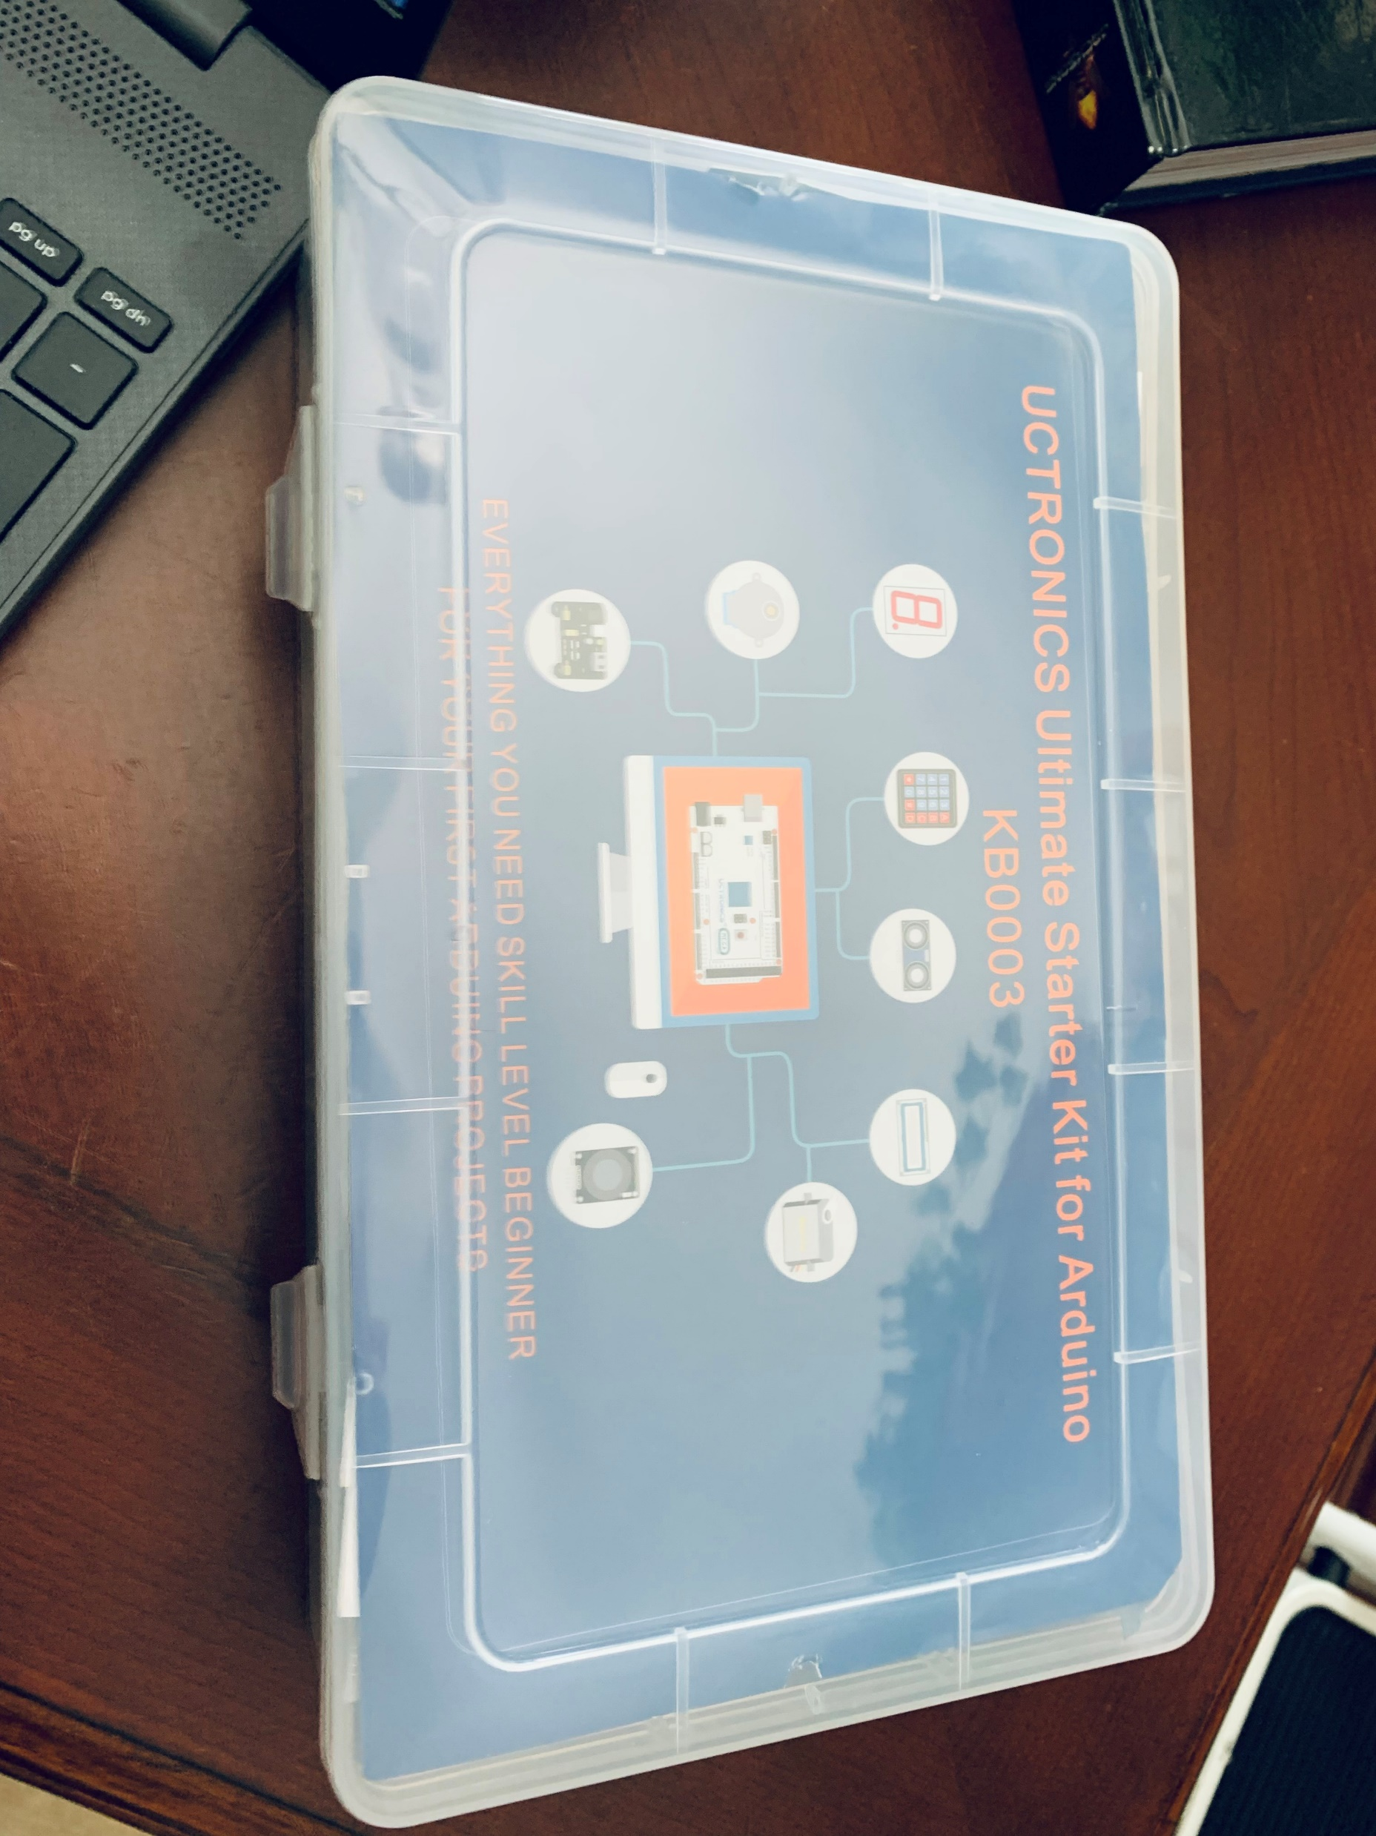
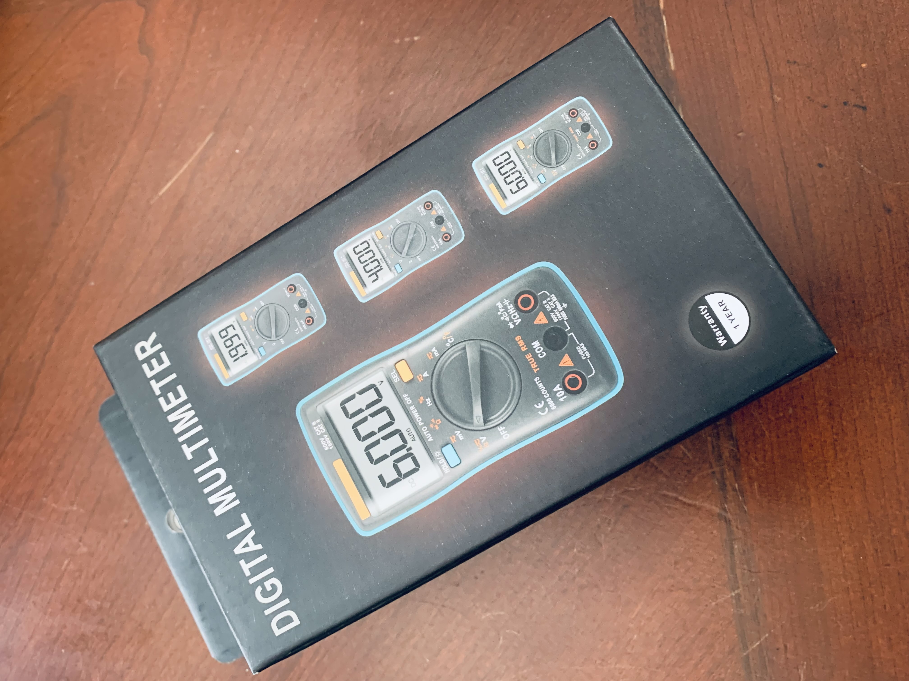
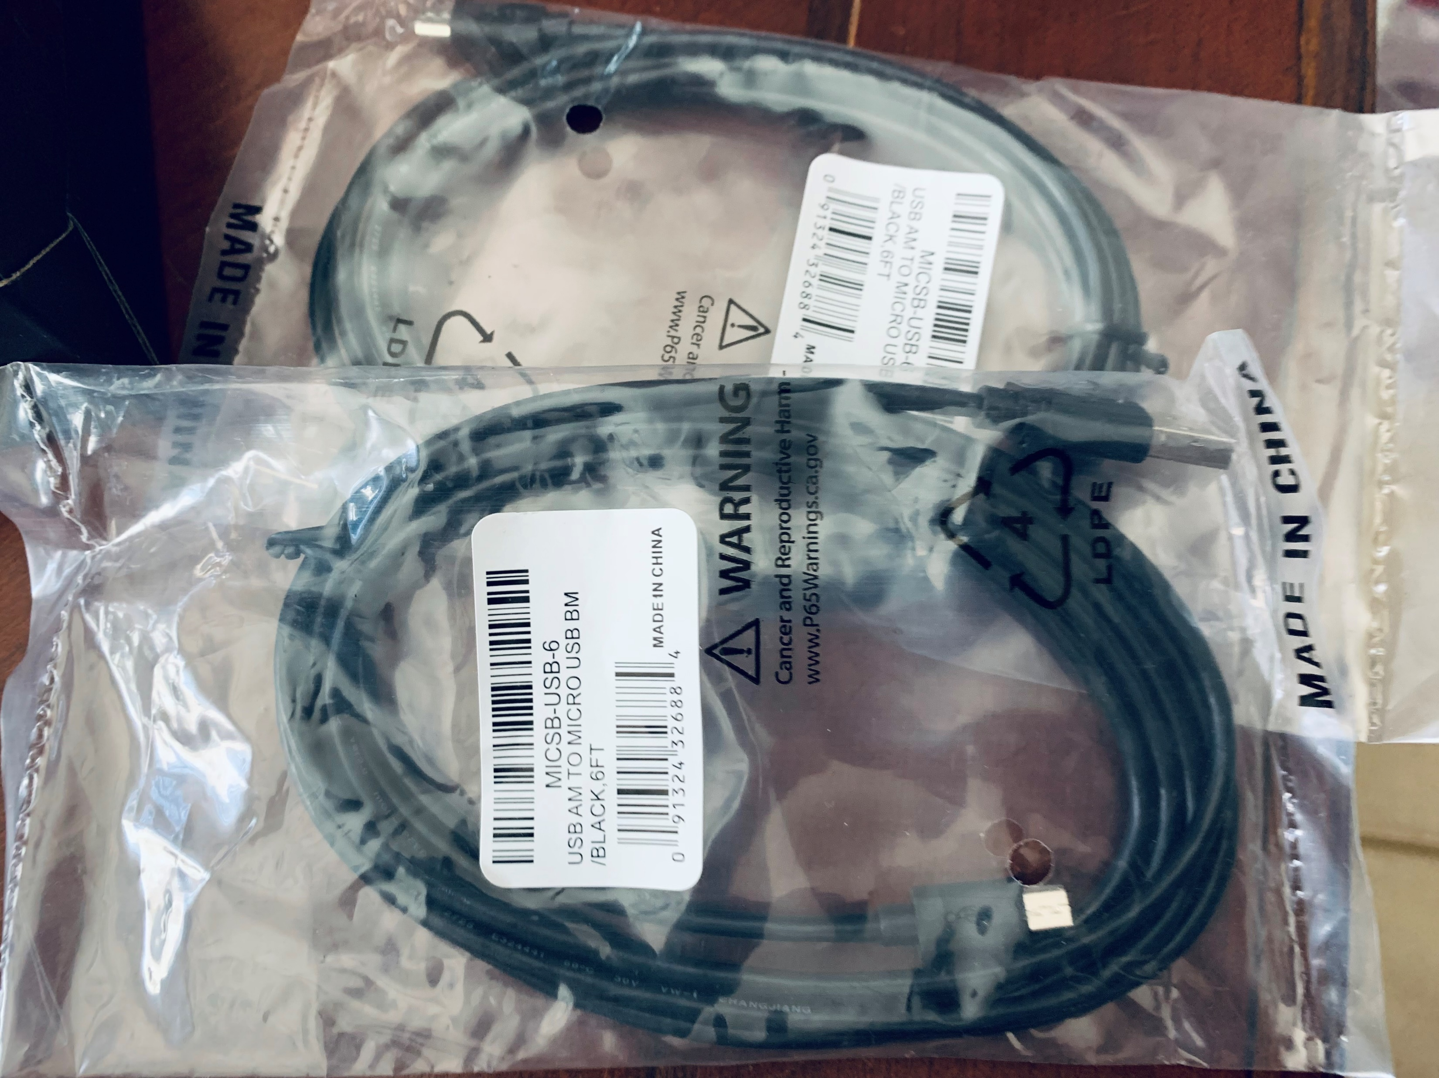
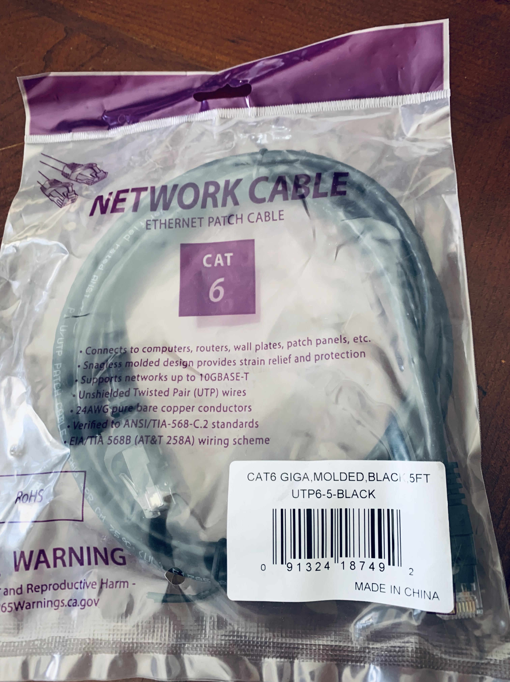
Inventory of IoT Kit
UCTRONICS Kit
ESP32 (2)
LCD Modules (2)
Breadboards (3)
Mini Router
Patch Cable
Digital Multi Meter
USB to Micro USB (2)

Slide 8
Organization of Project Components
Arduino Mega 2560
Breadboard
Resistor 10kΩ
LEDs
Ultrasonic Sensor
Active Buzzer
Photoresistor
Wires
USB Type B cable

Slide 9
Circuit with red LED on

Slide 10
Serial Monitor

Slide 11
Step 3: Add door sensor

Slide 12
Circuit of door closed with Green LED ON

Slide 13
Circuit of door open with Green LED OFF

Slide 14
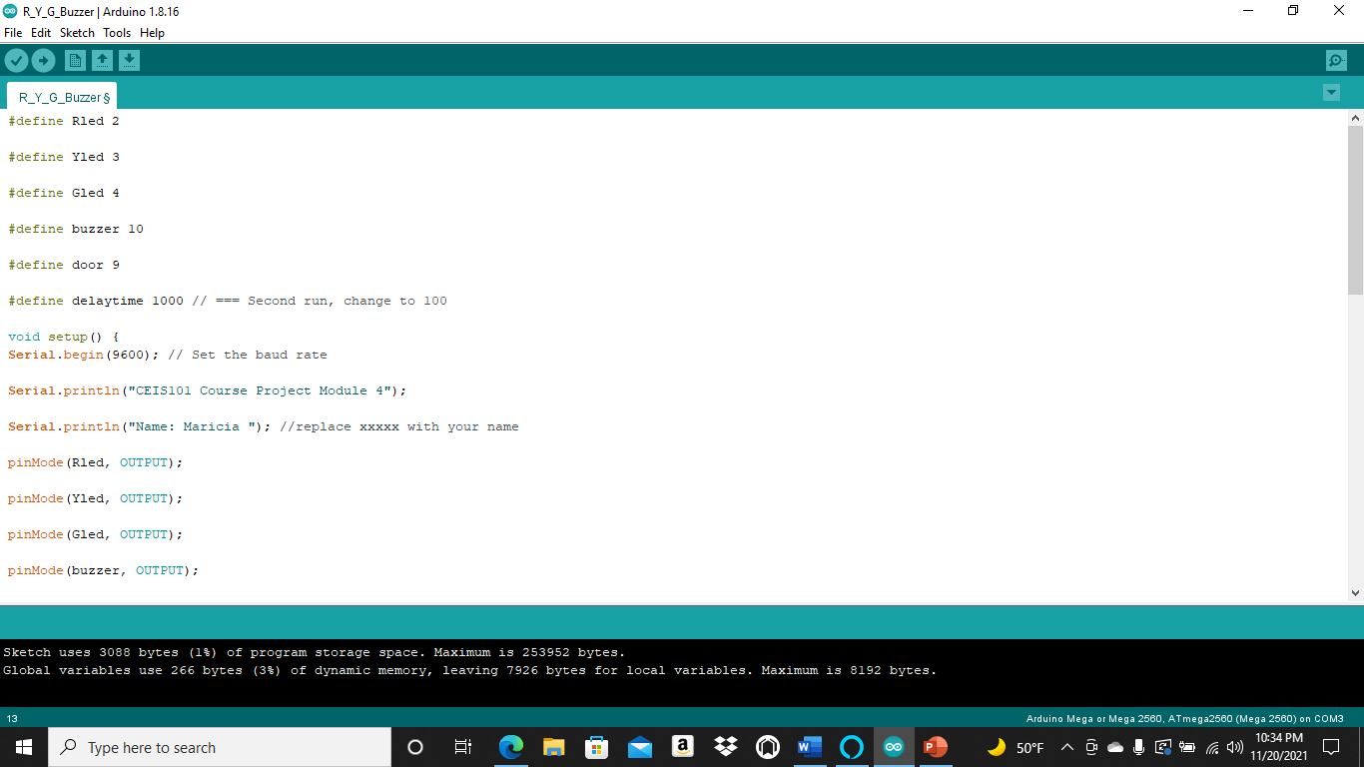
Arduino Code

Slide 15
Serial Monitor

Slide 16
Step 4 : Add distance sensor and Analyze Data

Slide 17
Circuit with green LED on

Slide 18
Circuit with yellow LED on

Slide 19
Circuit with red LED on

Slide 20
Arduino Code

Slide 21
Plot of data (graph from Excel)

Slide 22
Step 5: Add Automated Light

Slide 23
Circuit with automated LED off

Slide 24
Circuit with automated LED on

Slide 25
Arduino Code

Slide 26
Serial Monitor

Slide 27
Challenges & Obstacles
The biggest challenge I faced completing this project was getting the automated light sensor to work correctly. However, I overcame this obstacle by ensuring my wires, LED light, Photocell, and 10kresistor functioned correctly. In addition, I disconnected and reconnected my wires to ensure they were in the proper slots on the breadboard. These steps allowed me to successfully connect my automated light sensor and ensure it functioned properly.

Slide 28
Careers & Skills
The career path I want to take now that I have completed this course and project is to become a Software Engineer. I loved the process of building the automated home system, but I now know that I would prefer to work with the software side of engineering. The skills I learned are troubleshooting, how to navigate Arduino, how to build a prototype, and how to analyze data.

Slide 29
Conclusion
This course has provided me with basic knowledge of the IoT, AI, big data, and network security. I am eager to continue my path to learning more in-depth about the IoT and my future career field. I feel more confident learning about technology and how to help maintain and keep our IoT safe and secure.

